Slide 1
UPPER SIXTH ARTS
GEOGRAPHY
Lesson 4
Agriculture as a System and its Classification
Notes:
Good morning, class, and welcome to our geography lesson. I am your geography teacher, Mr Kamdem. Today we are starting Lesson 4: Agriculture as a System and its Classification.

Slide 2
CLASS INFO
Class, Chapter and Duration
Class | Upper Sixth Arts
Chapter | Module 6: Understanding and managing the dynamics of economic activities across the world in general and Cameroon in particular
Duration | 2 periods (2 × 50 minutes)
Notes:
This lesson is for Upper Sixth Arts. It belongs to Module 6: Understanding and managing the dynamics of economic activities across the world in general and Cameroon in particular. We shall need 2 periods to cover it.

Slide 3
IDENTIFICATION
Lesson Identification
Topic | Agricultural Systems
Sub-topic | The Agricultural Systems
Lesson | Lesson 4: Agriculture as a System and its Classification
Notions / Concepts | Farm system, inputs, processes, outputs, feedback, classification criteria.
Syllabus focus | Agriculture as a system of production; bases of classifying agriculture.
Competence | Learners are able to describe a farm as a system and explain the bases of classification.
Notes:
Our topic is Agricultural Systems, and the sub-topic is The Agricultural Systems. The key notions we shall use today are: farm system, inputs, processes, outputs, feedback, classification criteria. At the end, you should be able to do this: learners are able to describe a farm as a system and explain the bases of classification.

Slide 4

HOMEWORK CORRECTION
Correction of the Homework
Question (Lesson 3: Influences on Agriculture):
Explain why a crop grown in your area does well there.
Notes:
Before we start the new lesson, let us correct the homework I gave you at the end of Lesson 3: Influences on Agriculture. The question was: Explain why a crop grown in your area does well there. Take out your exercise books.

Slide 5
HOMEWORK CORRECTION
Correction: Possible Answer
Example: cotton does well around Garoua because of the hot climate with one rainy season, ferruginous soils, flat land, and support (seeds, fertiliser, buying) from SODECOTON.
Notes:
Here is a good answer. Example: cotton does well around Garoua because of the hot climate with one rainy season, ferruginous soils, flat land, and support (seeds, fertiliser, buying) from SODECOTON. Compare it with your own answer and correct your work in red.

Slide 6
LESSON PLAN
Lesson Plan
Correction of the homework
Objectives and recall
Real-life situation and action to take
Learning activities
Board summary
Evaluation, remediation and homework
Notes:
Here is the plan of our lesson today. First, we shall correct the homework. Then we shall look at the objectives and recall what you already know. After that, we shall study a situation from real life and the action to take, and do the learning activities. Finally, we shall copy the board summary, do the evaluation and the remediation, and I will give you the homework.

Slide 7
OBJECTIVES
Objectives
By the end of this lesson, you should be able to:
Describe the farm as a system.
Identify inputs, processes, outputs and feedback.
Notes:
Take your time to copy this part; we will continue together.

Slide 8
OBJECTIVES
Objectives (continued)
Explain the bases of classifying agriculture.
Notes:
By the end of this lesson, you should be able to do three things. Number 1: describe the farm as a system. Number 2: identify inputs, processes, outputs and feedback. Number 3: explain the bases of classifying agriculture.

Slide 9
PREVIOUS KNOWLEDGE
Previous Knowledge
A drainage basin is a system.
Farming uses land, labour and capital.
Notes:
Let us first remember what you already know. A drainage basin is a system. Farming uses land, labour and capital. Keep this in mind, because we shall build on it today.

Slide 10
REAL-LIFE SITUATION
Situation in Real Life
A cocoa farmer uses land, family labour, seedlings and fungicides. He harvests cocoa, sells it and uses the money to buy more fungicides the next year.
Notes:
Listen carefully to this situation from real life. A cocoa farmer uses land, family labour, seedlings and fungicides. He harvests cocoa, sells it and uses the money to buy more fungicides the next year. Think about it, because I am going to ask you some questions.

Slide 11
REAL-LIFE SITUATION
Situation: Question 1
What is the problem in the situation?
Notes:
Question 1: What is the problem in the situation? Think for a moment, then raise your hand to answer.

Slide 12
REAL-LIFE SITUATION
Answer
Learners want to see the farm as a system.
Notes:
Good. Learners want to see the farm as a system.

Slide 13
REAL-LIFE SITUATION
Situation: Question 2
Name two inputs.
Notes:
Question 2: Name two inputs. Think for a moment, then raise your hand to answer.

Slide 14
REAL-LIFE SITUATION
Answer
Land and labour (also seedlings, fungicides).
Notes:
Good. Land and labour (also seedlings, fungicides).

Slide 15
REAL-LIFE SITUATION
Situation: Question 3
What is the feedback?
Notes:
Question 3: What is the feedback? Think for a moment, then raise your hand to answer.

Slide 16
REAL-LIFE SITUATION
Possible Answer
Money from sales is reinvested in the farm.
Notes:
Good. Money from sales is reinvested in the farm.

Slide 17
ACTION TO TAKE
Action to Take
Analyse farms as systems to improve their inputs and outputs.
Notes:
From this situation, the action we are working towards in this lesson is the following: analyse farms as systems to improve their inputs and outputs.

Slide 18
JUSTIFICATION
Justification of the Lesson
This lesson helps us to analyse and classify farming systems.
Notes:
Why is this lesson important for you? This lesson helps us to analyse and classify farming systems.

Slide 19
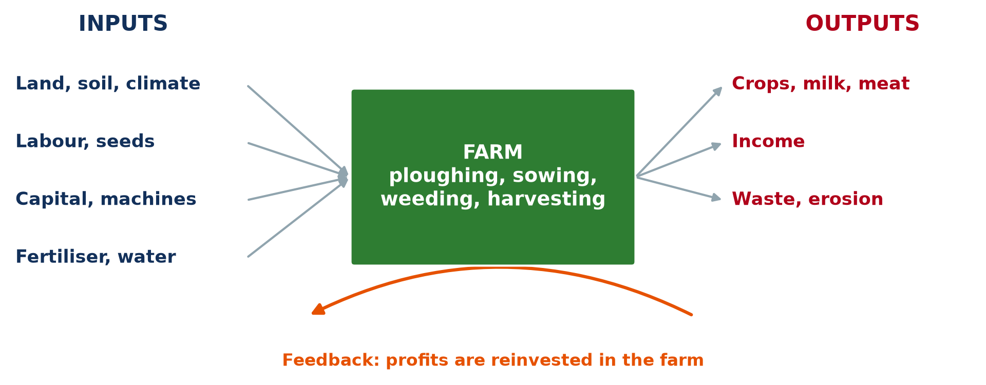
1. AGRICULTURE AS A SYSTEM
Activity 1
The farm as a system.
Notes:
Activity 1. Look carefully at this diagram: the farm as a system. Observe every detail before I ask the question.

Slide 20
1. AGRICULTURE AS A SYSTEM
Activity 1: Question
Name two inputs, two processes and two outputs of a farm.
Notes:
Here is the question for Activity 1: Name two inputs, two processes and two outputs of a farm. Take one minute to think and write your answer in your rough notebook.

Slide 21
1. AGRICULTURE AS A SYSTEM
Activity 1: Answer
Inputs: land, labour. Processes: sowing, harvesting. Outputs: crops, income.
Notes:
Let us check the answer together. Inputs: land, labour. Processes: sowing, harvesting. Outputs: crops, income.

Slide 22

1. AGRICULTURE AS A SYSTEM
Activity 2
Cocoa beans drying.
Notes:
Activity 2. Look carefully at this picture: cocoa beans drying. Observe every detail before I ask the question.

Slide 23
1. AGRICULTURE AS A SYSTEM
Activity 2: Question
Which process is shown in the photo?
Notes:
Here is the question for Activity 2: Which process is shown in the photo? Take one minute to think and write your answer in your rough notebook.

Slide 24
1. AGRICULTURE AS A SYSTEM
Activity 2: Answer
Drying cocoa beans after harvest.
Notes:
Let us check the answer together. Drying cocoa beans after harvest.

Slide 25
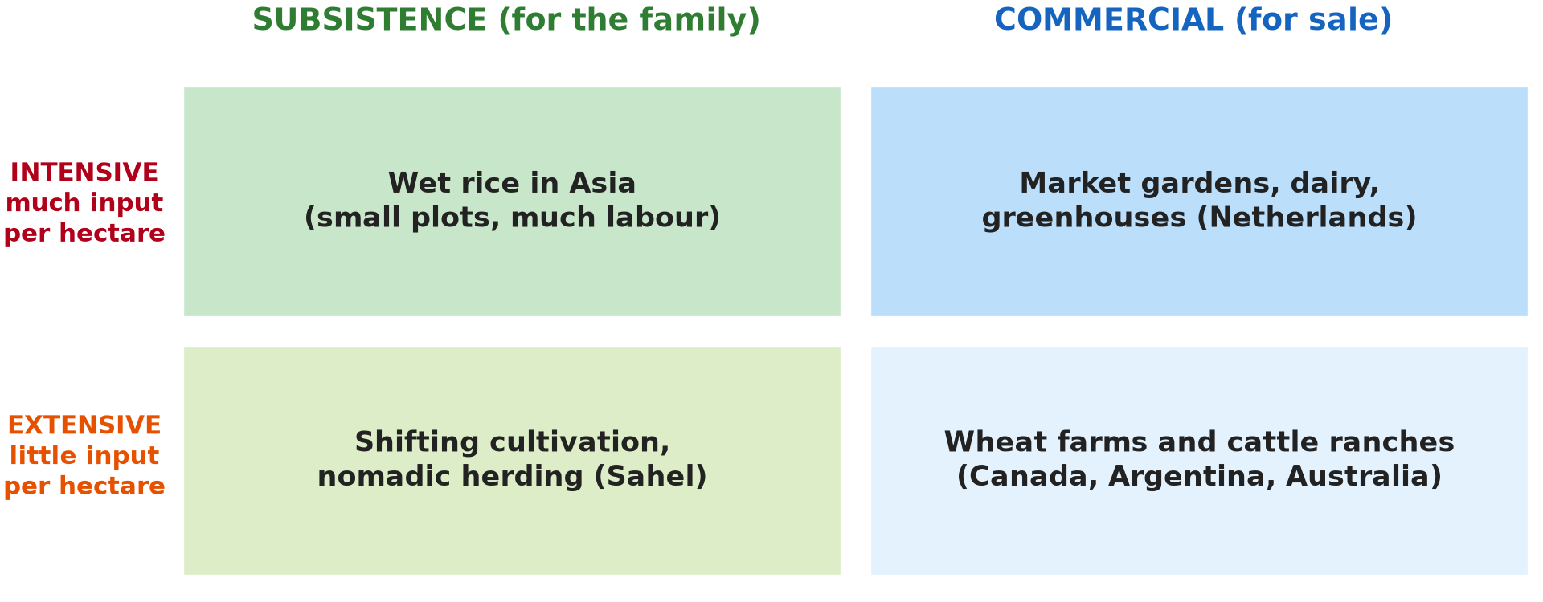
2. BASIS OF CLASSIFICATION
Activity 3
Four types of farming.
Notes:
Activity 3. Look carefully at this diagram: four types of farming. Observe every detail before I ask the question.

Slide 26
2. BASIS OF CLASSIFICATION
Activity 3: Question
Give three bases for classifying agriculture.
Notes:
Here is the question for Activity 3: Give three bases for classifying agriculture. Take one minute to think and write your answer in your rough notebook.

Slide 27
2. BASIS OF CLASSIFICATION
Activity 3: Answer
Amount of inputs, purpose (subsistence or commercial), level of technology.
Notes:
Let us check the answer together. Amount of inputs, purpose (subsistence or commercial), level of technology.

Slide 28

2. BASIS: LEVEL OF TECHNOLOGY
Activity 4
A combine harvester.
Notes:
Activity 4. Look carefully at this picture: a combine harvester. Observe every detail before I ask the question.

Slide 29
2. BASIS: LEVEL OF TECHNOLOGY
Activity 4: Question
Which basis of classification does this machine illustrate?
Notes:
Here is the question for Activity 4: Which basis of classification does this machine illustrate? Take one minute to think and write your answer in your rough notebook.

Slide 30
2. BASIS: LEVEL OF TECHNOLOGY
Activity 4: Answer
The level of technology (and capital input).
Notes:
Let us check the answer together. The level of technology (and capital input).

Slide 31

2. BASIS: NUMBER OF PRODUCTS
Activity 5
A mixed farm.
Notes:
Activity 5. Look carefully at this picture: a mixed farm. Observe every detail before I ask the question.

Slide 32
2. BASIS: NUMBER OF PRODUCTS
Activity 5: Question
How can the number of products classify farms?
Notes:
Here is the question for Activity 5: How can the number of products classify farms? Take one minute to think and write your answer in your rough notebook.

Slide 33
2. BASIS: NUMBER OF PRODUCTS
Activity 5: Answer
Monoculture grows one product; mixed farming combines several.
Notes:
Let us check the answer together. Monoculture grows one product; mixed farming combines several.

Slide 34
BOARD SUMMARY
Board Summary
Topic: Agricultural Systems
Sub-topic: The Agricultural Systems
Lesson 4: Agriculture as a System and its Classification
Notes:
Now we are going to copy the board summary. Write the title and the headings neatly in your notebooks. I will give you enough time for each slide, so do not rush.

Slide 35
BOARD SUMMARY
1. Agriculture as a System of Production
A farm works as a system with:
Inputs: Physical inputs are land, soil, climate and water; human inputs are labour, capital, seeds, machines and fertiliser. Inputs vary with the type of farming.
Notes:
Let us copy Agriculture as a System of Production. A farm works as a system with. On this slide we have Inputs. Write each point on a new line, with the key term first, and explain it in your own words when we revise. When you finish, we go to the next slide.

Slide 36
BOARD SUMMARY
1. Agriculture as a System of Production (continued)
Processes: Ploughing, sowing, weeding, spraying, harvesting, milking and processing change inputs into products. Processes need labour and energy.
Notes:
We continue with Agriculture as a System of Production. On this slide we have Processes. Write each point on a new line, with the key term first, and explain it in your own words when we revise. When you finish, we go to the next slide.

Slide 37
BOARD SUMMARY
1. Agriculture as a System of Production (continued)
Outputs and feedback: Outputs are crops, milk, meat, income and also waste and erosion. Feedback occurs when profits are reinvested or losses reduce inputs.
Notes:
We continue with Agriculture as a System of Production. On this slide we have Outputs and feedback. Write each point on a new line, with the key term first, and explain it in your own words when we revise.

Slide 38
BOARD SUMMARY
1. Agriculture as a System of Production
Illustration: the farm as a system
Notes:
Now draw this illustration in your notebook: the farm as a system. Give it a title and label it clearly.

Slide 39
BOARD SUMMARY
2. Bases of Classifying Agriculture
Agriculture is classified using the following criteria:
Original home of plants and amount of inputs: Crops can be native or introduced (cocoa came from America). Intensive farming uses many inputs per hectare, extensive farming few.
Notes:
Let us copy Bases of Classifying Agriculture. Agriculture is classified using the following criteria. On this slide we have Original home of plants and amount of inputs. Write each point on a new line, with the key term first, and explain it in your own words when we revise. When you finish, we go to the next slide.

Slide 40
BOARD SUMMARY
2. Bases of Classifying Agriculture (continued)
Level of technology: Traditional farming uses hoes and cutlasses, while modern farming uses machines, improved seeds and chemicals. Technology raises yields.
Notes:
We continue with Bases of Classifying Agriculture. On this slide we have Level of technology. Write each point on a new line, with the key term first, and explain it in your own words when we revise. When you finish, we go to the next slide.

Slide 41
BOARD SUMMARY
2. Bases of Classifying Agriculture (continued)
Purpose of the farmer: Subsistence farming produces food for the family, while commercial farming produces for sale. Many farmers in Cameroon do both.
Notes:
We continue with Bases of Classifying Agriculture. On this slide we have Purpose of the farmer. Write each point on a new line, with the key term first, and explain it in your own words when we revise. When you finish, we go to the next slide.

Slide 42
BOARD SUMMARY
2. Bases of Classifying Agriculture (continued)
Number and combination of products: Monoculture produces one crop, as in plantations. Mixed farming combines crops and animals.
Notes:
We continue with Bases of Classifying Agriculture. On this slide we have Number and combination of products. Write each point on a new line, with the key term first, and explain it in your own words when we revise.

Slide 43
BOARD SUMMARY
2. Bases of Classifying Agriculture
Illustration: classifying agriculture
Notes:
Now draw this illustration in your notebook: classifying agriculture. Give it a title and label it clearly.

Slide 44
FORMATIVE EVALUATION
Evaluation 1
Describe a farm as a system.
Notes:
Now let us check what you have understood. Question 1: Describe a farm as a system. Answer in your exercise book.

Slide 45
FORMATIVE EVALUATION
Expected Answer
Inputs (land, labour, capital) go through processes (sowing, harvesting) to give outputs (crops, income), with feedback.
Notes:
The expected answer is: inputs (land, labour, capital) go through processes (sowing, harvesting) to give outputs (crops, income), with feedback. If you got it right, well done.

Slide 46
FORMATIVE EVALUATION
Evaluation 2
Give three bases of classifying agriculture.
Notes:
Now let us check what you have understood. Question 2: Give three bases of classifying agriculture. Answer in your exercise book.

Slide 47
FORMATIVE EVALUATION
Expected Answer
Inputs, purpose, technology (also products, origin of plants).
Notes:
The expected answer is: inputs, purpose, technology (also products, origin of plants). If you got it right, well done.

Slide 48
REMEDIATION
Remediation
Fill in the blanks:
Land and labour are farm ______.
Crops and income are ______.
Growing one crop is ______.
Notes:
For those who need more practice, fill in the blanks in your exercise book. The answers are: number 1, inputs; number 2, outputs; number 3, monoculture.

Slide 49
HOMEWORK
Homework
Draw your family farm (or a farm you know) as a system.
Notes:
For your homework: Draw your family farm (or a farm you know) as a system. We shall correct it at the beginning of our next lesson.

Slide 50
NEXT LESSON
Next Lesson
Our next lesson will be on:
Lesson 5: Types of Agricultural Systems
Notes:
Our next lesson will be on Lesson 5: Types of Agricultural Systems. Thank you for your attention, and see you next time.

Slide 51
BILINGUAL GAME
Bilingual Game (Jeu Bilingue)
English | Français
System | Le système
Input | L'intrant
Output | La production
Feedback | La rétroaction
Monoculture | La monoculture
Harvest | La récolte
Notes:
Let us play the bilingual game. I say a word in English, and you give me the French word. Then we do the reverse.

Slide 52
LOGBOOK
Official Logbook (1/2)
Module / Topic | Agricultural Systems
Lesson Title | Lesson 4: Agriculture as a System and its Classification
Expected Learning Outcomes | Describe the farm as a system. Identify inputs, processes, outputs and feedback. Explain the bases of classifying agriculture.
Competence | Learners are able to describe a farm as a system and explain the bases of classification.
Notes:
I record this information in the official logbook of the class after the lesson.

Slide 53
LOGBOOK
Official Logbook (2/2)
Matter Taught | Agriculture as a System of Production; Bases of Classifying Agriculture.
Evaluation | Formative evaluation and remediation exercise.
Homework | Draw your family farm (or a farm you know) as a system.
Enrolment / Present / Absent | ____ / ____ / ____
Achievement | To be completed after the lesson.
Notes:
I complete the second page of the logbook: the matter taught, the evaluation, the homework and the attendance.

Slide 54
TEACHER'S NOTE
Teacher's Note
Timing: Homework correction, plan, objectives 8 min | Recall, situation, action 10 min | 5 activities 30 min | Board summary (copying) 30 min | Evaluation, remediation 10 min | Homework, next lesson 5 min | Logbook 7 min
Without the projector (Activity 1): draw the system.
Without the projector (Activity 2): list steps of cocoa farming.
Without the projector (Activity 3): list the bases.
Without the projector (Activity 4): compare hoe and tractor.
Without the projector (Activity 5): give examples.
Notes:
This slide is for me, the teacher: it gives the timing of the lesson and what to do if the projector is not available.

Slide 55
REFERENCES
References
National Geography Syllabus, MINESEC/IGE/IP-SS, 2019 — Module 6 (Economic Geography).
Photo, Activity 2: “Farmer sun drying cocoa beans” by IITA Image Library, CC BY-NC 2.0, via Flickr (https://www.flickr.com/photos/45796762@N03/4598613756)
Photo, Activity 4: “John Deere Combine” by SnoShuu, CC BY-NC-ND 2.0, via Flickr (https://www.flickr.com/photos/85888233@N00/2776467094)
Photo, Activity 5: “Timid” by tricky (rick harrison), CC BY-NC-SA 2.0, via Flickr (https://www.flickr.com/photos/81851211@N00/205287304)
Diagrams and animations: drawn for this lesson (Geography Department).
Notes:
These are the references and picture credits used to prepare this lesson.

